Slide 1

Ghost Touch
Sprint 3 Update
Sophia Evans & Tsani Rogers

Slide 2
Sprint 3 Goals
-Solder micro arduino, wifi module and custom pcb together.
-Create a harmless script to run on target devices for testing purposes.

Slide 3
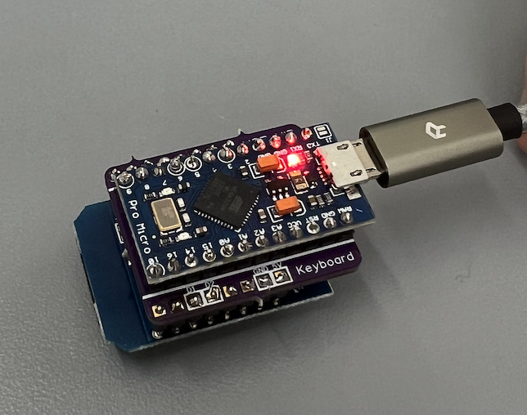
Sprint 3 Achievements
-Soldered micro arduino, PCB and wifi module together.
-Arduino code was successfully compiled
and uploaded.

Slide 4
What Didn’t Work
-Issues uploading code to wifi module on MAC. Will try running code and uploading it from PC instead.

Slide 5
Sprint 4 Goals
-Push limits of wifi duck. How bad can we make it?
-Start writing original scripts for final presentation.
-Have a simple demo of the project for sprint 4 presentations.
-Embed device into a charger to simulate a malicious port.

Slide 6


